Slide 1

SWP391: FINAL PROJECT PRESENTATION
FOOTBALL BOOKING TICKET
SE1817 - G5

Slide 2





Project Overview
Group Members
Quach The Kiet - HE170015
Do Duc Vinh - HE176906
Do Tien Thuat - HE173070
Nguyen Canh Duong - HE173210
Tran Anh Quan - HE170941
Management tools
Source code
RDS
Project Tracking
Solution stack

Slide 3
Project Overview
Football Booking Ticket website is a website selling football tickets exclusively for My Dinh Stadium. The website aims to make it convenient for customers to buy tickets for matches.
On the website, users can book tickets for upcoming exciting matches, learn about their favorite teams and update the latest news every day. Payment service via VNPAY is quick and easy
Administrators can easily manage and view team lists, seasons, news, matches and revenue statistics through matches.

Slide 4
Project Overview
Project communication: meetings, task assignments,...
Meetings: Regular meetings at 9:00 PM are held to discuss progress, resolve issues, and ensure everyone understands the goals and tasks at hand.
Task assignments: Tasks are clearly assigned to each team member, ensuring everyone knows their responsibilities and how their work contributes to the overall project goals.
Communication tools: Use Facebook for communication, Google Meet for daily meetings, and Github for project management.

Slide 5
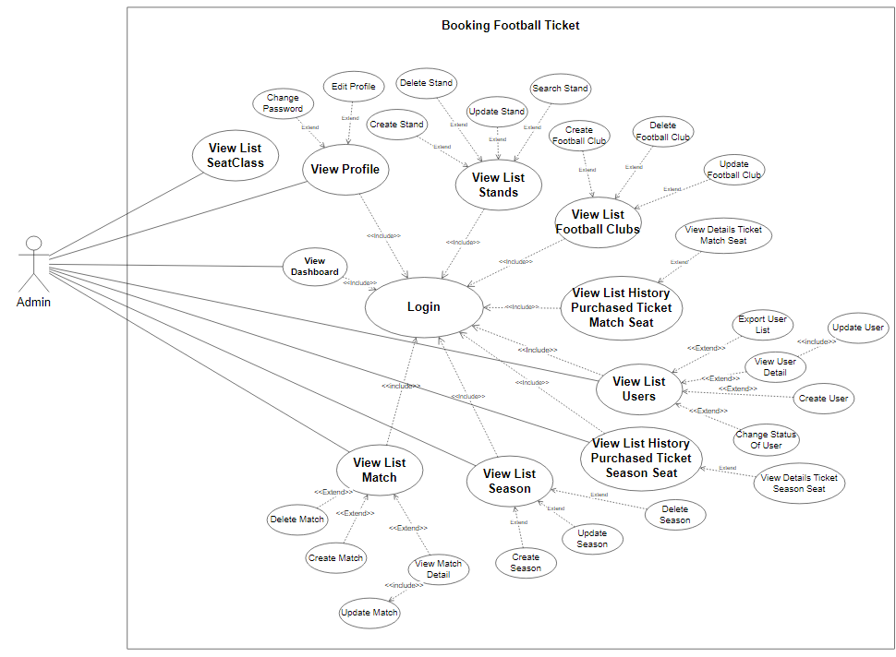
Product Requirements Use Case Diagrams
UC For Admin:

Slide 6
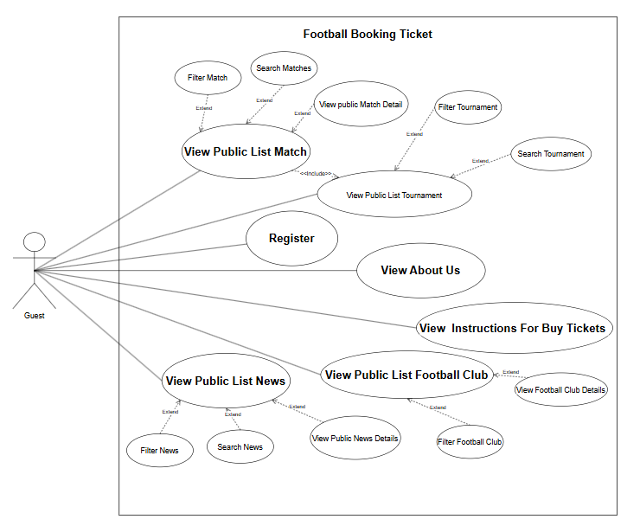
Product Requirements Use Case Diagrams
UC For Guest:

Slide 7
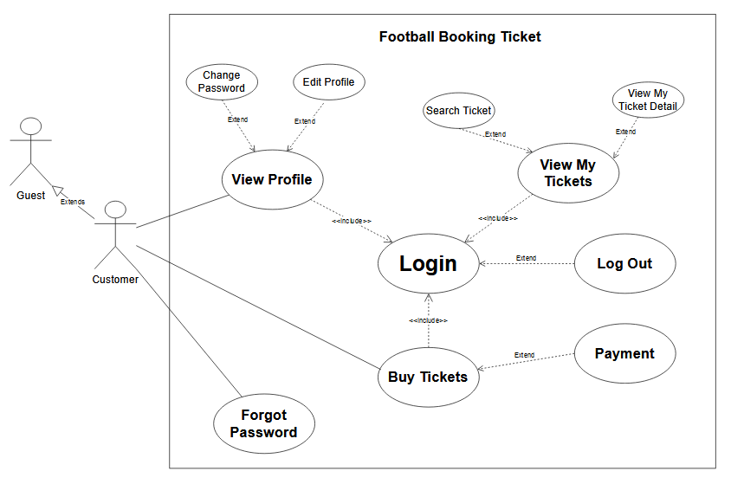
Product Requirements Use Case Diagrams
UC For Customer:

Slide 8
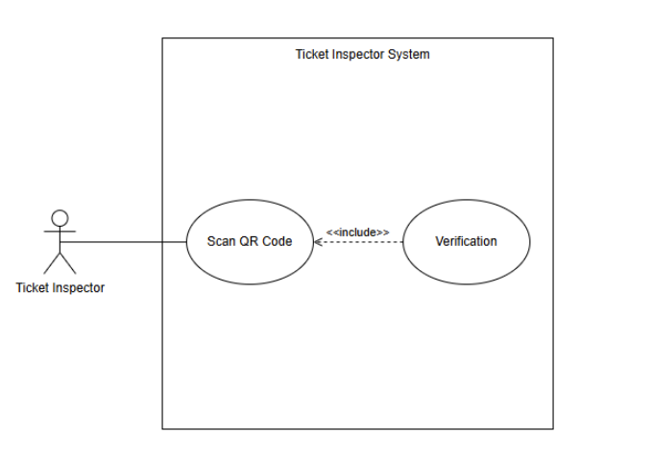
Product Requirements Use Case Diagrams
UC For Inspector:

Slide 9
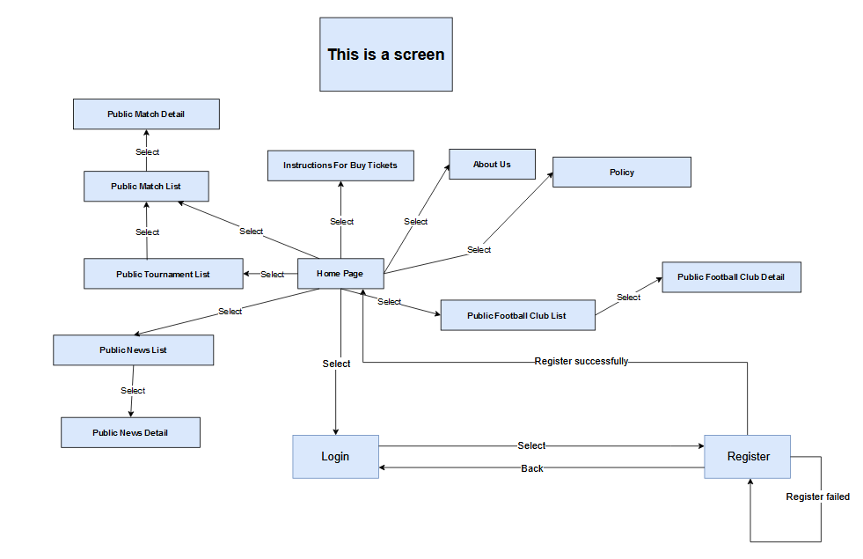
Product Requirements Product Functionalities
Screenflow:
Guest:

Slide 10
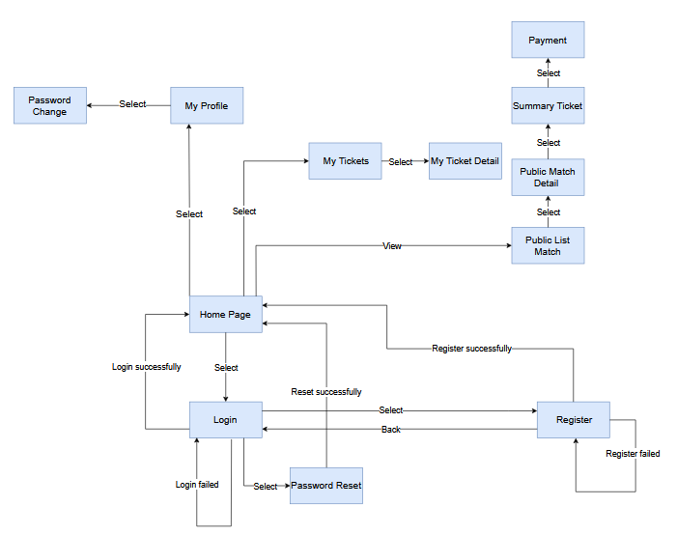
Product Requirements Product Functionalities
Screenflow:
b. Customer:

Slide 11
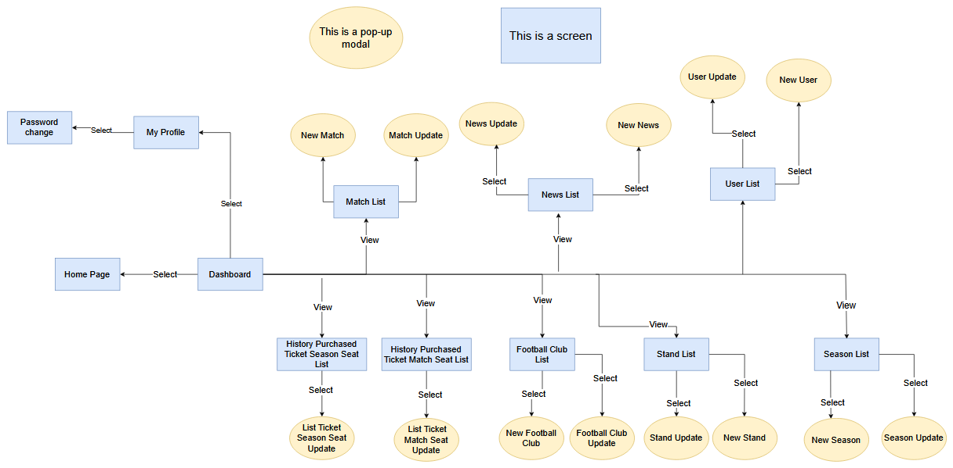
Product Requirements Product Functionalities
Screenflow:
c. Admin:

Slide 12
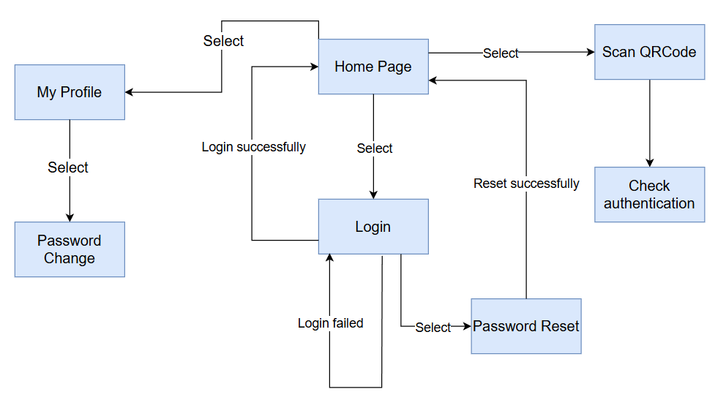
Product Requirements Product Functionalities
Screenflow:
d. Inspector:

Slide 13
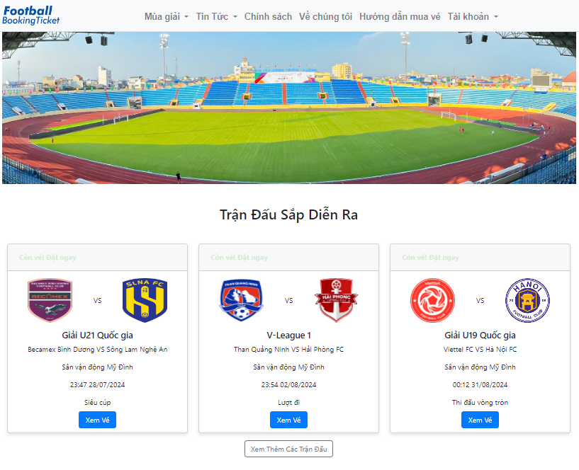
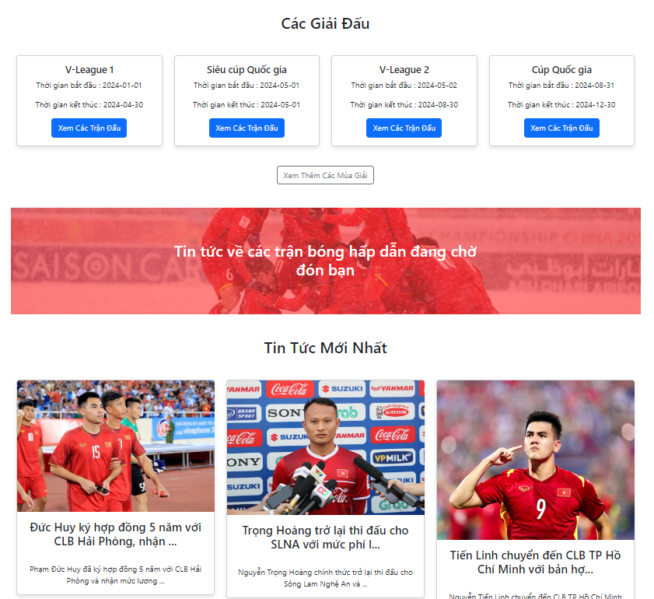
Product Requirements Main Screen UI Design
HomePage:

Slide 14
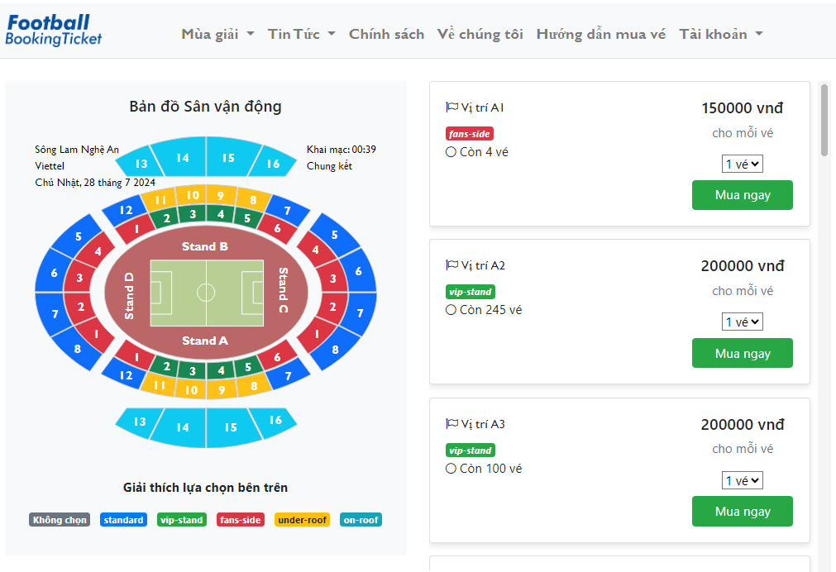
Product Requirements Main Screen UI Design
Public Match Detail:

Slide 15
Product Requirements Main Flow UI Design
Public Match Detail:

Slide 16
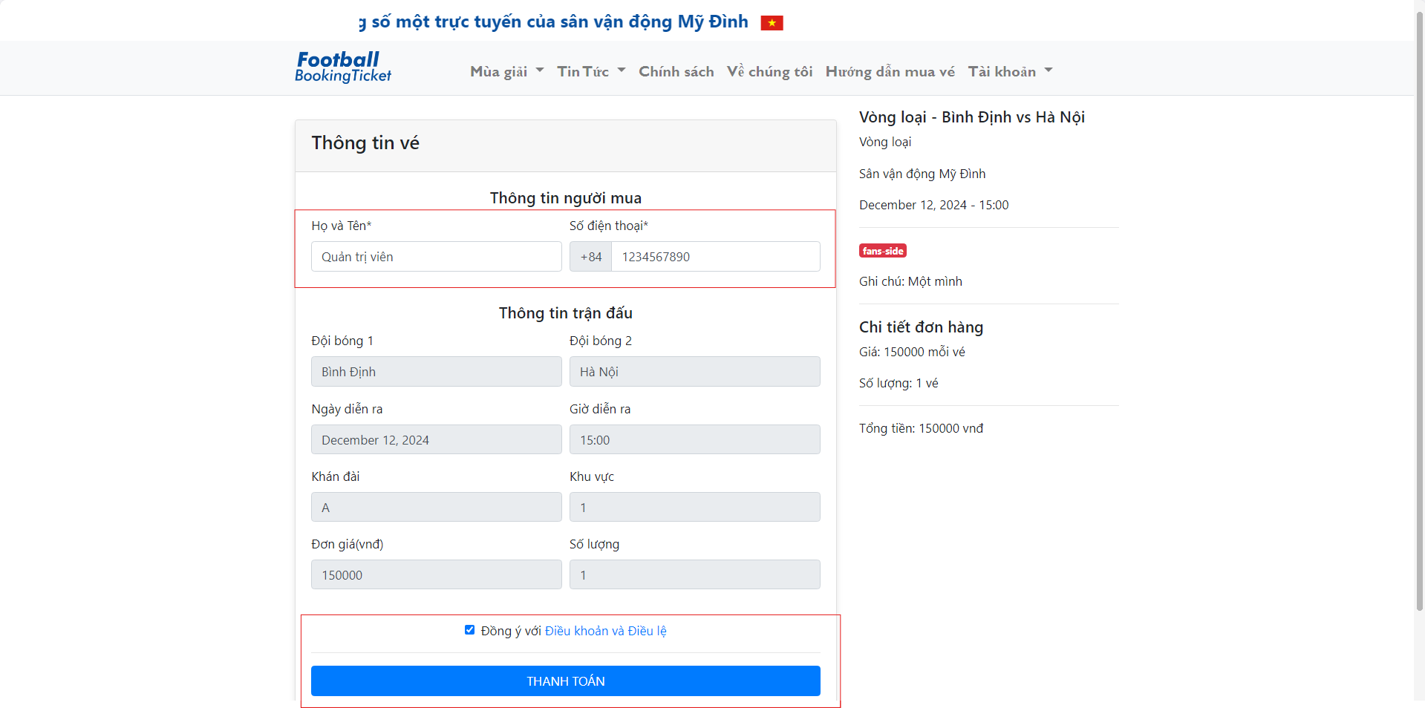
Product Requirements Main Flow UI Design
Summary ticket:

Slide 17
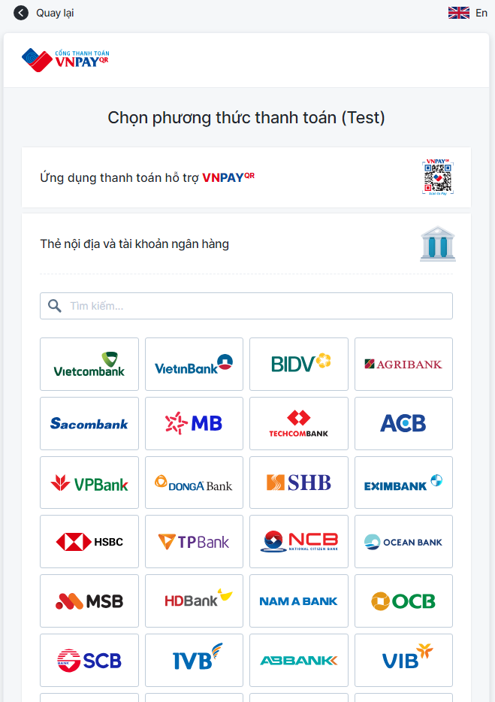
Product Requirements Main Flow UI Design
Select payment method:

Slide 18
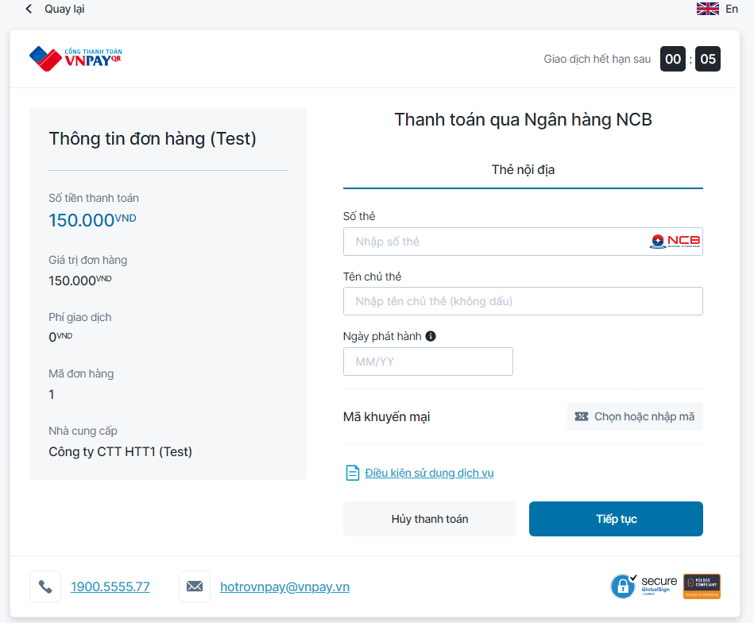
Product Requirements Main Flow UI Design
Payment:

Slide 19
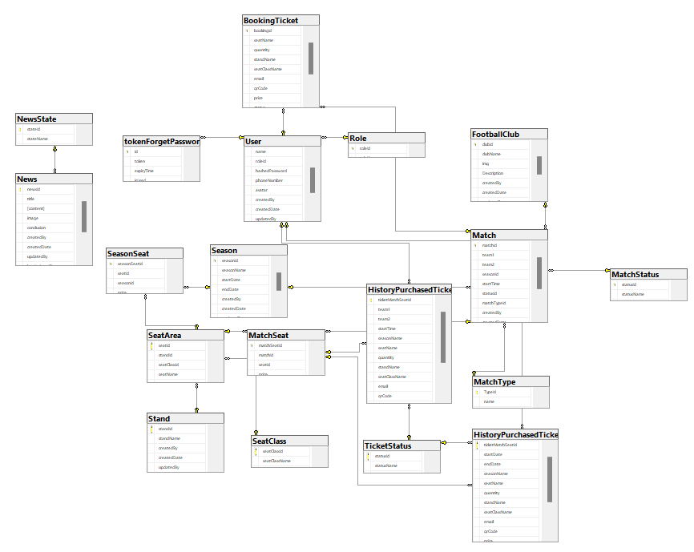
System Design Database Design

Slide 20
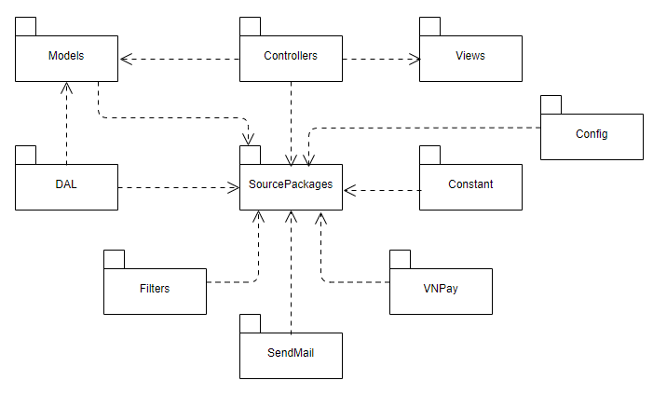
System Design Package Diagram

Slide 21
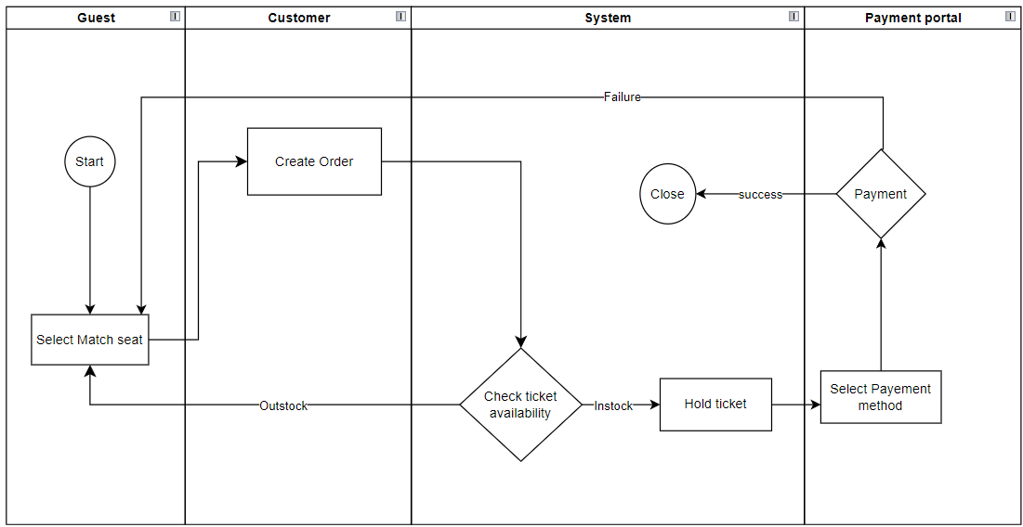
Swimlane
Buy Ticket

Slide 22


